Slide 1
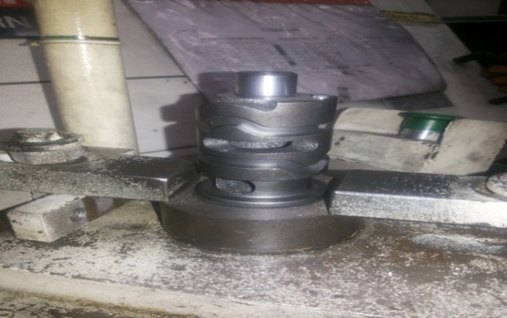
P15
KAIZEN NO :- 10
ACTIVITY
KK
QM
PM
JH
SHE
OT
DM
E&T
KAIZEN IDEA SHEET
TPM CIRCLE NAME: Achiever
LOSS NO. / STEP
DEPT :- MACHINE SHOP
RESULT AREA
P
Q
A,B,C
C
D
S
M
CELL:- D/C
CELL NAME:- A189 HPT
MACHINE / STAGE :- MAZAK
OPERATION :- RIVET PRESSING
KAIZEN THEME :. To Reduce Rejection due to collar crack.
IDEA :- Fixture to be modified.
Problem / Present Status:-A189 HTP collar broken/crack during rivet pressing operation.
COUNTERMEASURE:-
Fixture modified as component resting changed from collar width face to Dia.32 face side.
BENCHMARK
Collar break rejection.
TARGET
Zero rejection.
KAIZEN START
14.05.2016
KAIZEN FINISH
16.05.2016
TEAM MEMBERS : Someshwar Salunkhe , Amol Patil
BENEFITS :-
1) Improve quality
2)Collar Breakage Cost Saved
After
KAIZEN SUSTENANCE
RESULT :-
Collar broken problem zero.
Collar damage problem
WHAT TO DO :- N.A
HOW TO DO :- N.A
WHY - WHY ANALYSIS :-
Why1 :- A189 collar broken Problem.
Why2 :- Excess Load on Collar during Rivet Pressing.
Why3:- Component rest on collar during pressing.
Why 3:- Basic design of Fixture .
ROOT CAUSE Basic design of Fixture .
REGISTRATION NO. & DATE : 16.05.2016
SCOPE & PLAN FOR HORIZONTAL DEPLOYMENT
REGISTERED BY :- Someshwar Salunkhe
SR.
NO.
CELL
TARGET
RESPONSIBILITY
STATUS
MANAGER’S SIGN :- D. Y . Pawar
1
---
-------
-----------

